Slide 1
Are video games recession proof?
Shinyoung Park, Henry Brunngraber, Aldo Aragon

Slide 2
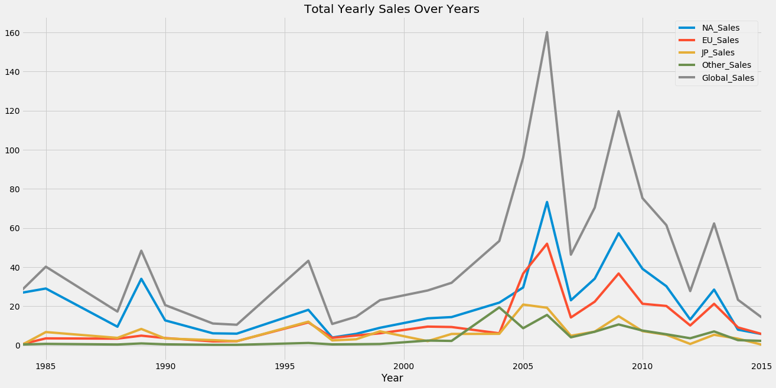
Yearly Video Game Sales (1985-2015)
As video games have grown in mainstream popularity over the years, yearly global sales have grown to a peak in 2006. Beginning at ~2012, we see a decline due to the emergence digital distribution platforms.

Slide 3
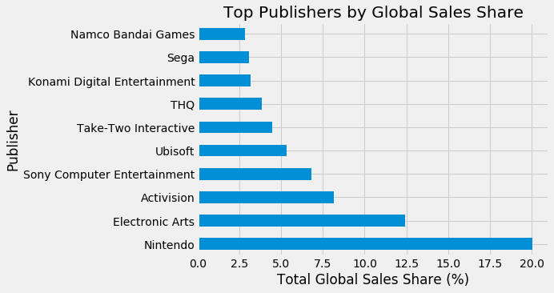
Best Selling Publishers
Excluding Nintendo and Sony as they are primarily hardware companies, we find that Take-Two, Ubisoft, Activision, and EA are the top publishers we will focus on for this story. In particular, we call attention to EAs dominance and explore why this is.

Slide 4
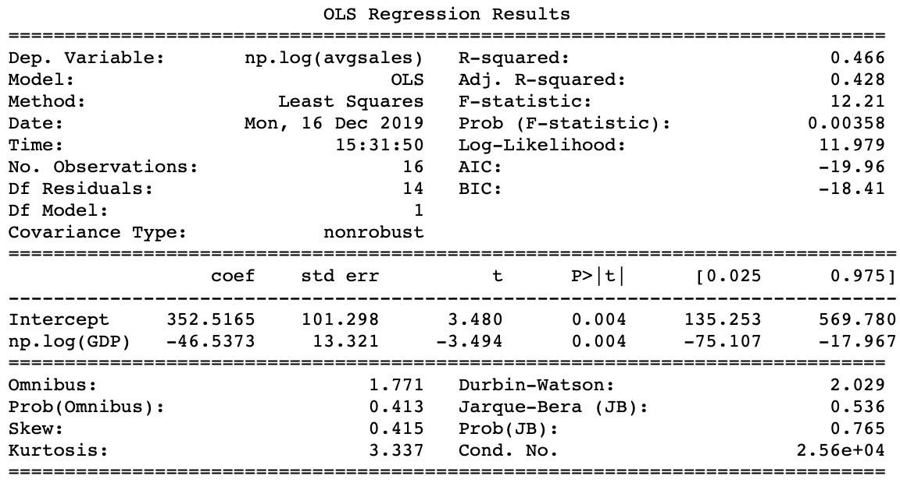
Regression: Volatility Analysis
The first regression shows that the elasticity of North American video game sales against US GDP growth between 2000 and 2015 is negative. The coefficient of the second regression (β1 = -0.0057) indicates that as US GDP growth increases by 1 percent(unit), the North American average sales decrease by 5700 dollars. The relationship is statistically significant at the 95% confidence level.
Such results suggest that video game sales may have a characteristic of an inferior good. However, we cannot be entirely conclusive as other factors, such as increasing popularity of digital game sales, may be affecting the sales numbers in the dataset.

Slide 5
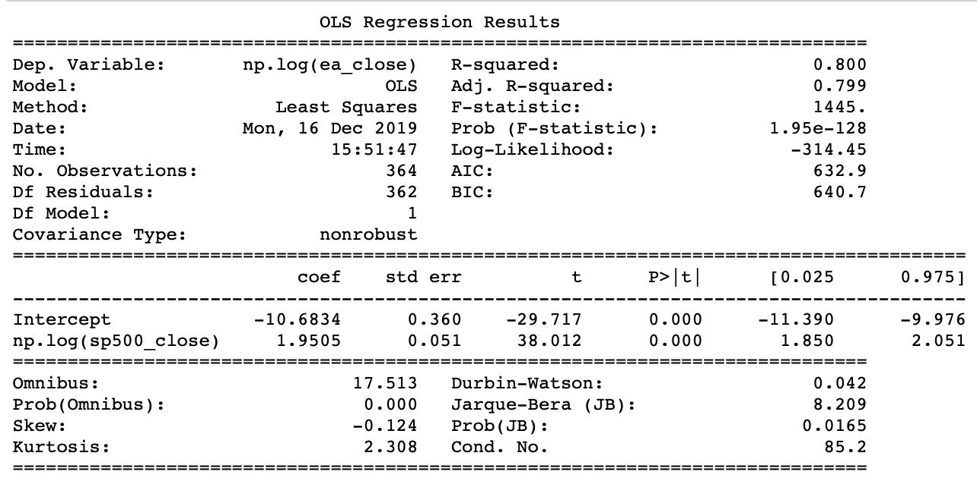
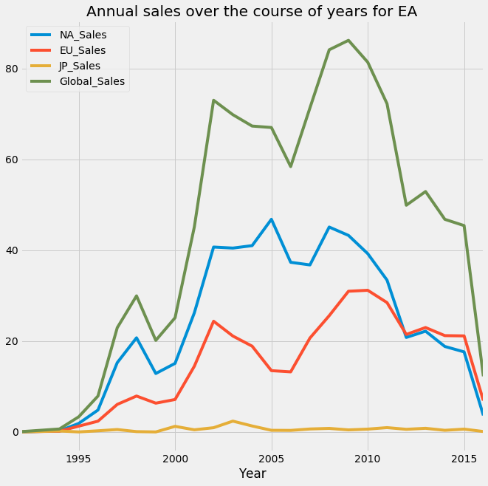
Regression: Publisher Performance
EA has outsold publishing peers with hit, yearly franchises in top genres (sports, action, shooter). This regression indicates that EA’s stock price elasticity against the S&P 500 is positive with a significant p-value meaning that EA’s share prices are likely to rise and fall as the market rises and falls. However, EA shows the lowest correlation to overall market trends while posting high sales figures. We believe EA is the most promising long-term investment because of its annually released hit franchises in high-grossing genres.

Slide 6
Conclusion:
Analysts and investors learning about the video game industry should consider three things:
Video games show qualities of an inferior good, potentially making it a good investment in a downturn.
However, stock prices for major publishers follow overall market cycles suggesting sales figures are just one factor that drive variability in stock price.
EA’s dominant sales and relatively low correlation to market cycles suggest this is a promising, long-term investment.
An important video game industry trend is the growth of digital distribution platforms driving more digital sales and more in-game purchases. This is a great area for further research and an encouraging sign for EA as an investment as the company successfully monetizes this new digital ecosystem with key franchises.

